Slide 1
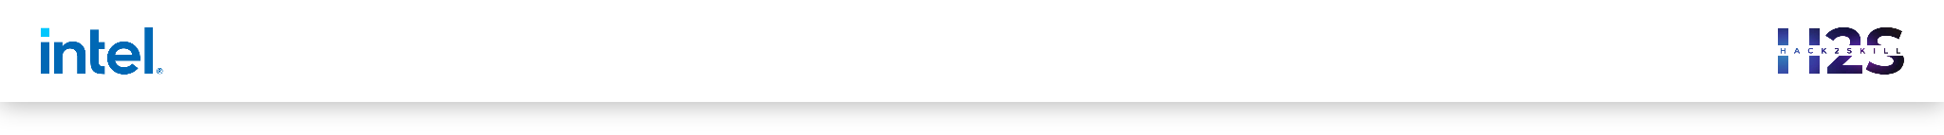

Guidelines
Feel free to use any other template of your choice, given it covers all the mentioned points of the sample template
The ideal size of the presentation should not be more than 10 slides.
At this stage the evaluation will only be made on the basis of the prototype.
In case of queries drop in a mail at support@hack2skill.com

Slide 2
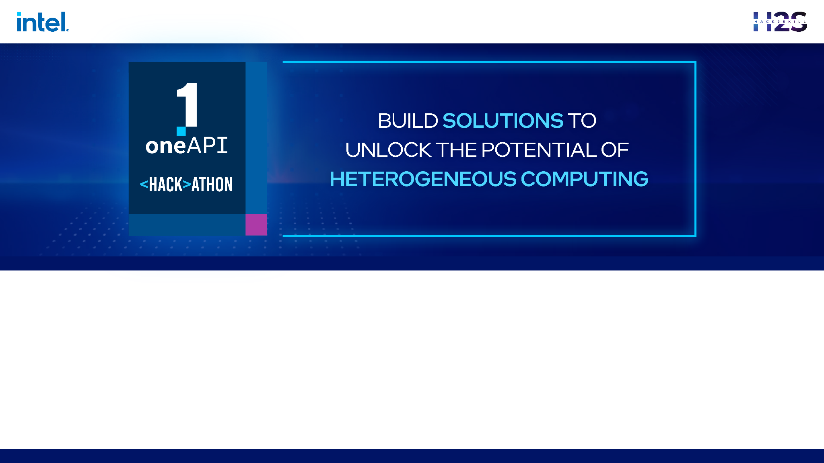
Project Name: Object Detection for Autonomous Vehicles
Team Name : CyberSKILL
Team Members :

Slide 3
Problem Statement
Autonomous vehicles require accurate and efficient object detection systems to perceive their surroundings and make informed decisions.
Challenge: Developing a robust and real-time object detection solution to handle complex environments, diverse object classes, and varying lighting conditions.

Slide 4
Architecture – Impact of oneAPI/SYCL (How oneAPI /SYCL helped you?)
oneAPI/SYCL: Unified programming model harnessing heterogeneous computing platforms.
Impact: Seamless utilization of CPUs and GPUs for parallel processing Maximized performance for real-time object detection.

Slide 5
Core components of oneAPI/SYCL used in the project
SYCL (Single-source C++ Heterogeneous Programming for OpenCL):
Higher-level programming model simplifying development for heterogeneous platforms.
Single-source approach for writing C++ code and offloading computations to different devices.
oneAPI DPC++ Compiler:
Enables high-level SYCL code compilation targeting diverse hardware platforms.
Efficient execution and optimization of SYCL code for improved performance and portability.
oneDNN Library (oneAPI Deep Neural Network Library):
Optimized building blocks for deep learning applications.
Provides efficient primitives for convolutional neural networks used in object detection tasks.

Slide 6
Demo Video/Live Demo
Please elaborate oneAPI/SYCL usage
https://drive.google.com/file/d/1QQYbUBWLNNlRhJGs9WOAmB-UJejiYGsx/view?usp=sharing

Slide 7
GitHub Link (Codes should be public and available after hackathon also)
https://github.com/palsuryaofficio/intel-oneAPI

Slide 8
Results Summary (focus on unique aspects of oneAPI/SYCL that you have used)
Performance Boost:
Utilization of parallel processing capabilities resulted in significant performance improvements compared to single-threaded CPU implementations.
Real-time object detection achieved, a crucial requirement for autonomous vehicles.
Heterogeneous Platform Utilization:
Efficient utilization of CPUs and GPUs within a single programming model.
Leverage the strengths of each device, enhancing performance and resource utilization.
Code Portability:
SYCL programming model ensures code portability across different hardware platforms.
Seamless deployment on a wide range of devices, providing scalability and adaptability.

Slide 9
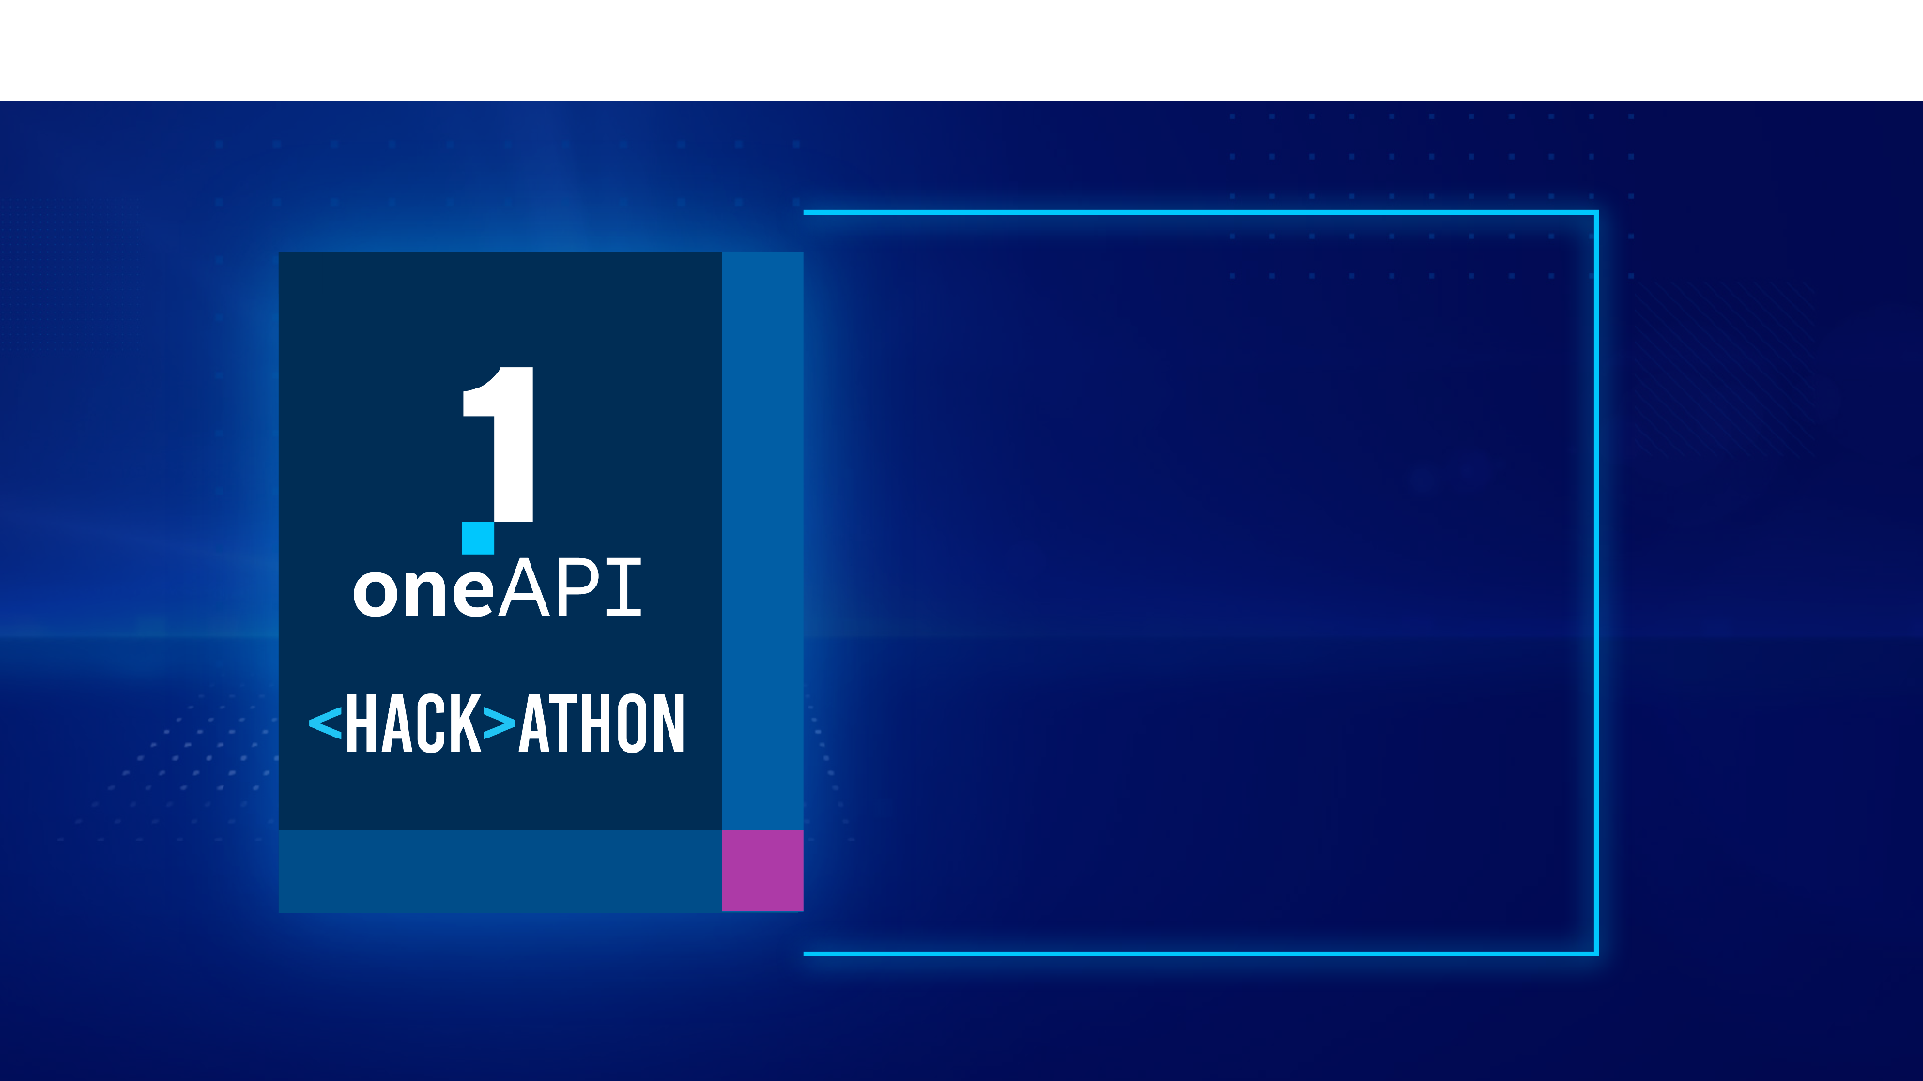
THANK YOU

